Slide 1
MINI CAPSTONE PROJECT
"Detailed Analysis of Rental Trends, Peak Hours, Film Popularity, and Store Performance“
Presented by
Anjalle Thoutam
16/08/24

Slide 2
AGENDA
Rental Trends Analysis
Analyze monthly rental trends.
Determine peak rental hours in a day.
Film Popularity Analysis
Identify the top 10 most rented films.
Determine the most popular film categories.
Store Performance Evaluation
Identify the store with the highest rental revenue.
Assess rental distribution by staff members.
Purpose:
Provide insights into rental patterns, film popularity, and store performance using the MavenMovies database.

Slide 3
RENTAL TREND ANALYSIS
This SQL query retrieves the monthly rental trends data from the MavenMovies database.
SELECT
YEAR(rental_date) AS Year,
MONTH(rental_date) AS Month,
COUNT(*) AS Rental_Count
FROM rental
GROUP By YEAR(rental_date),MONTH(rental_date)
ORDER BY Year, Month;

Slide 4
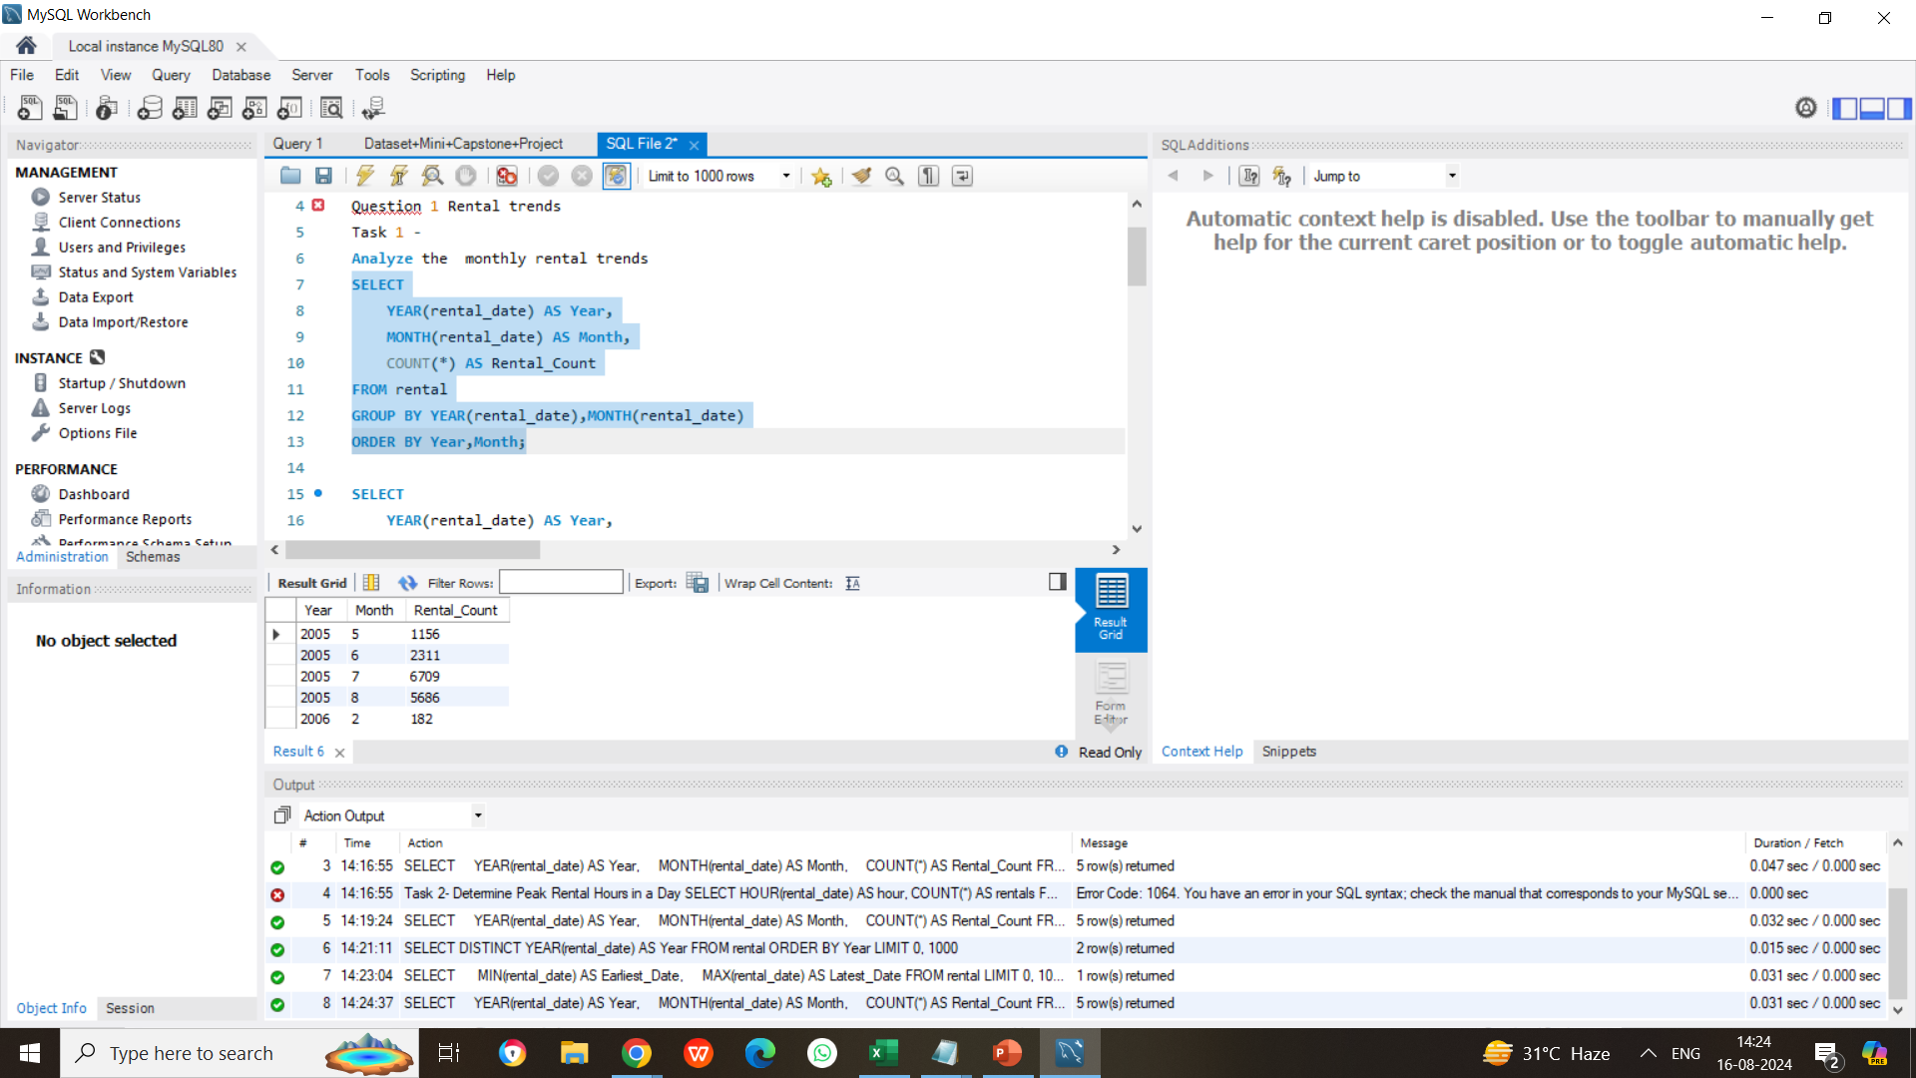
Screenshot showing the SQL query execution for monthly rental trends.

Slide 5
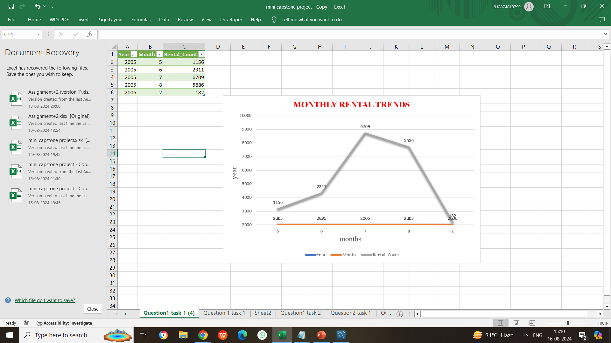
Visualization of Chart Line chart illustrating monthly rental trends

Slide 6
Peak Rental Hours Analysis
SQL query used to identify peak rental hours in a day.
SELECT
HOUR(rental_date) AS Hour,
COUNT(*) AS Rental_Count
FROM rental
GROUP BY HOUR(rental_date)
ORDER BY Hour;

Slide 7
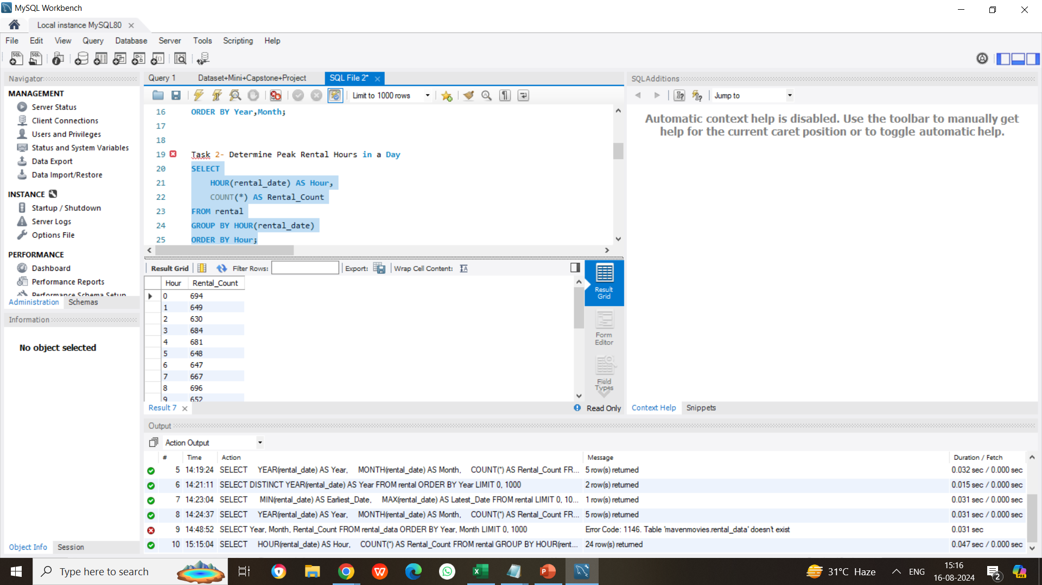
Screenshot of SQL Query for Determining Peak Rental Hours

Slide 8
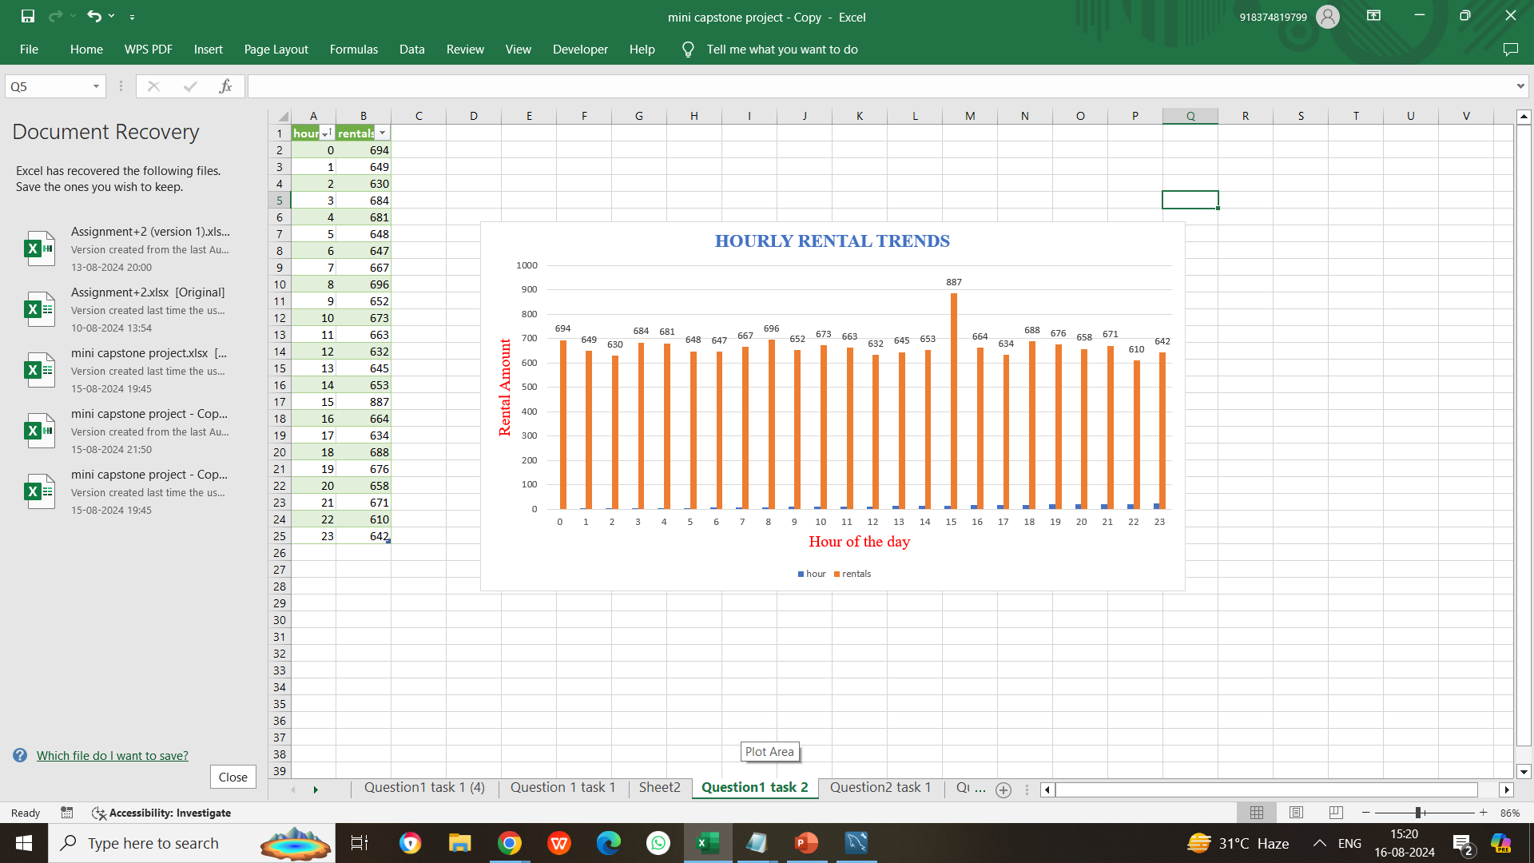
Screenshot of column chart showing the peak rental hours

Slide 9
TOP 10 MOST RENTAL FILMS
QUERY :
SELECT f.title AS Film_Title, COUNT(*) AS Rental_Count
FROM rental r
JOIN inventory i ON r.inventory_id = i.inventory_id
JOIN film f ON i.film_id = f.film_id
GROUP BY f.title
ORDER BY Rental_Count DESC
LIMIT 10;

Slide 10
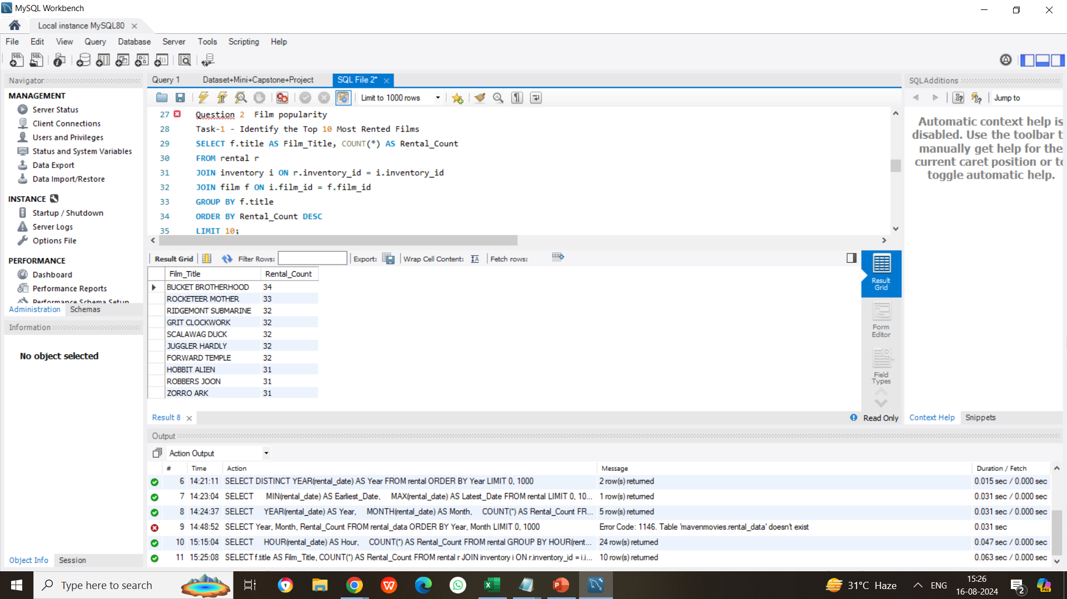
Screenshot of query showing the top 10 most rented films

Slide 11
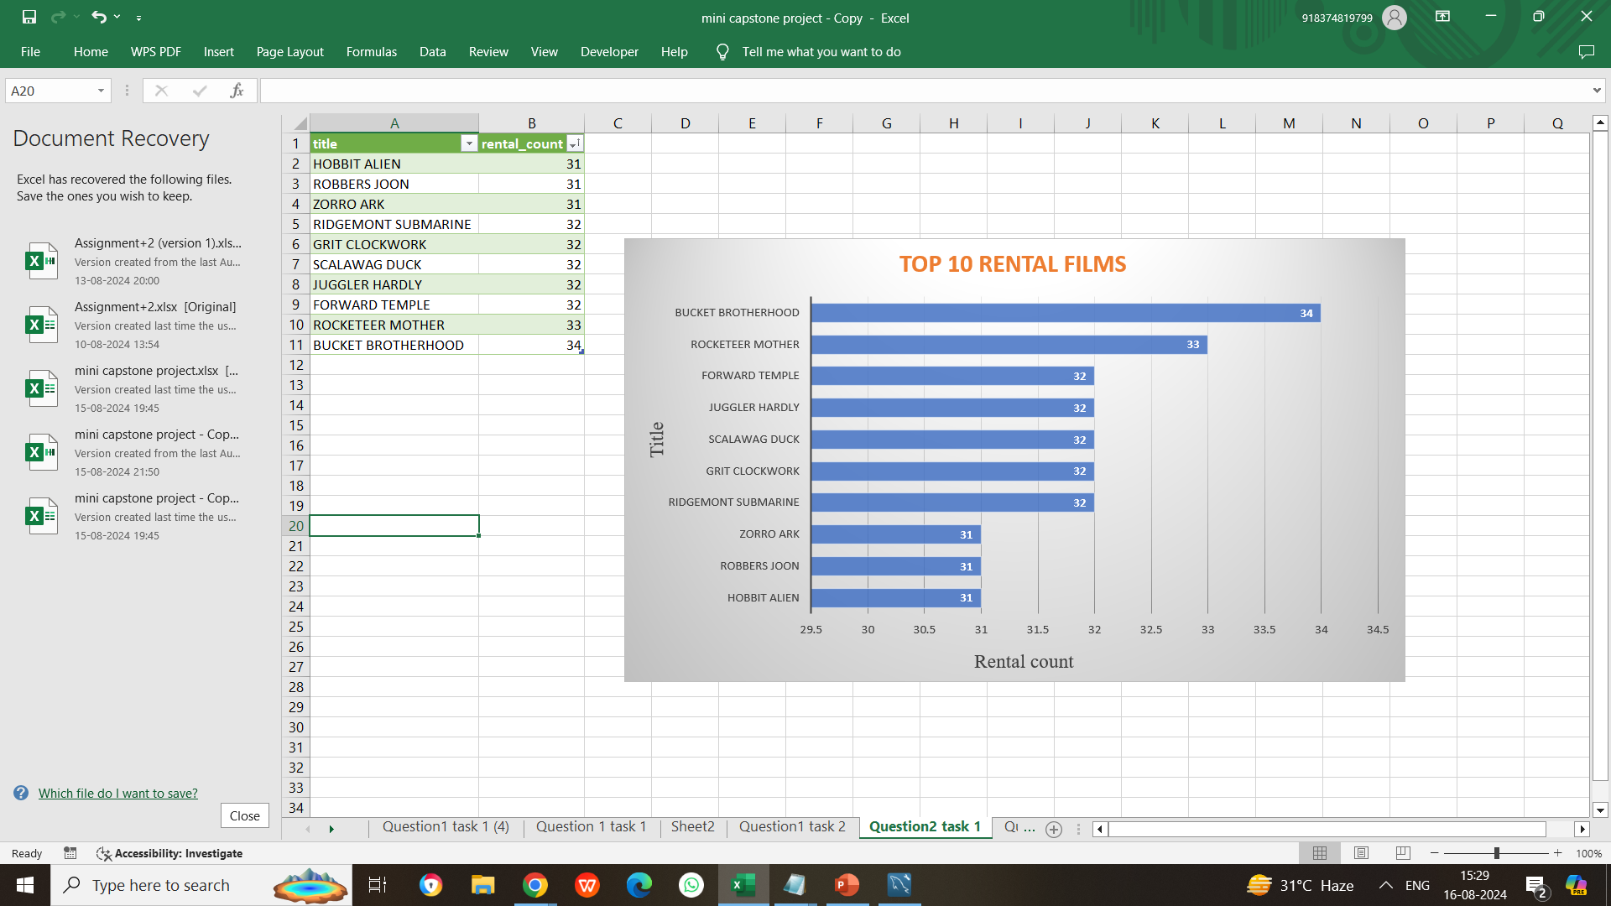
Visualization of bar chart showing top 10 most rented films

Slide 12
Film categories with highest rentals query
SELECT c.name AS Category, COUNT(*) AS Rental_Count
FROM rental r
JOIN inventory i ON r.inventory_id = i.inventory_id
JOIN film f ON i.film_id = f.film_id
JOIN film_category fc ON f.film_id = fc.film_id
JOIN category c ON fc.category_id = c.category_id
GROUP BYc.name
ORDER BY Rental_Count DESC;

Slide 13
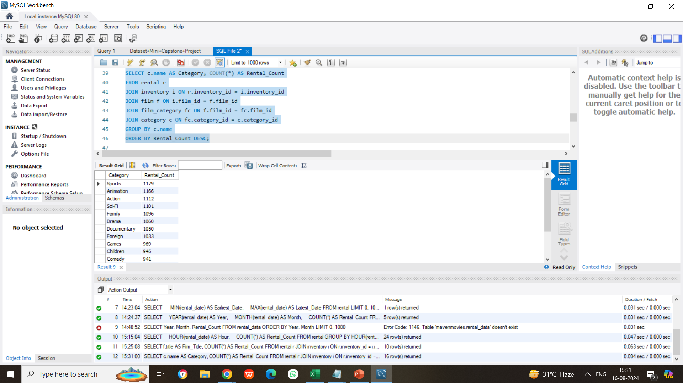
Screenshot finding film categories with highest rentals in my sql workbench

Slide 14
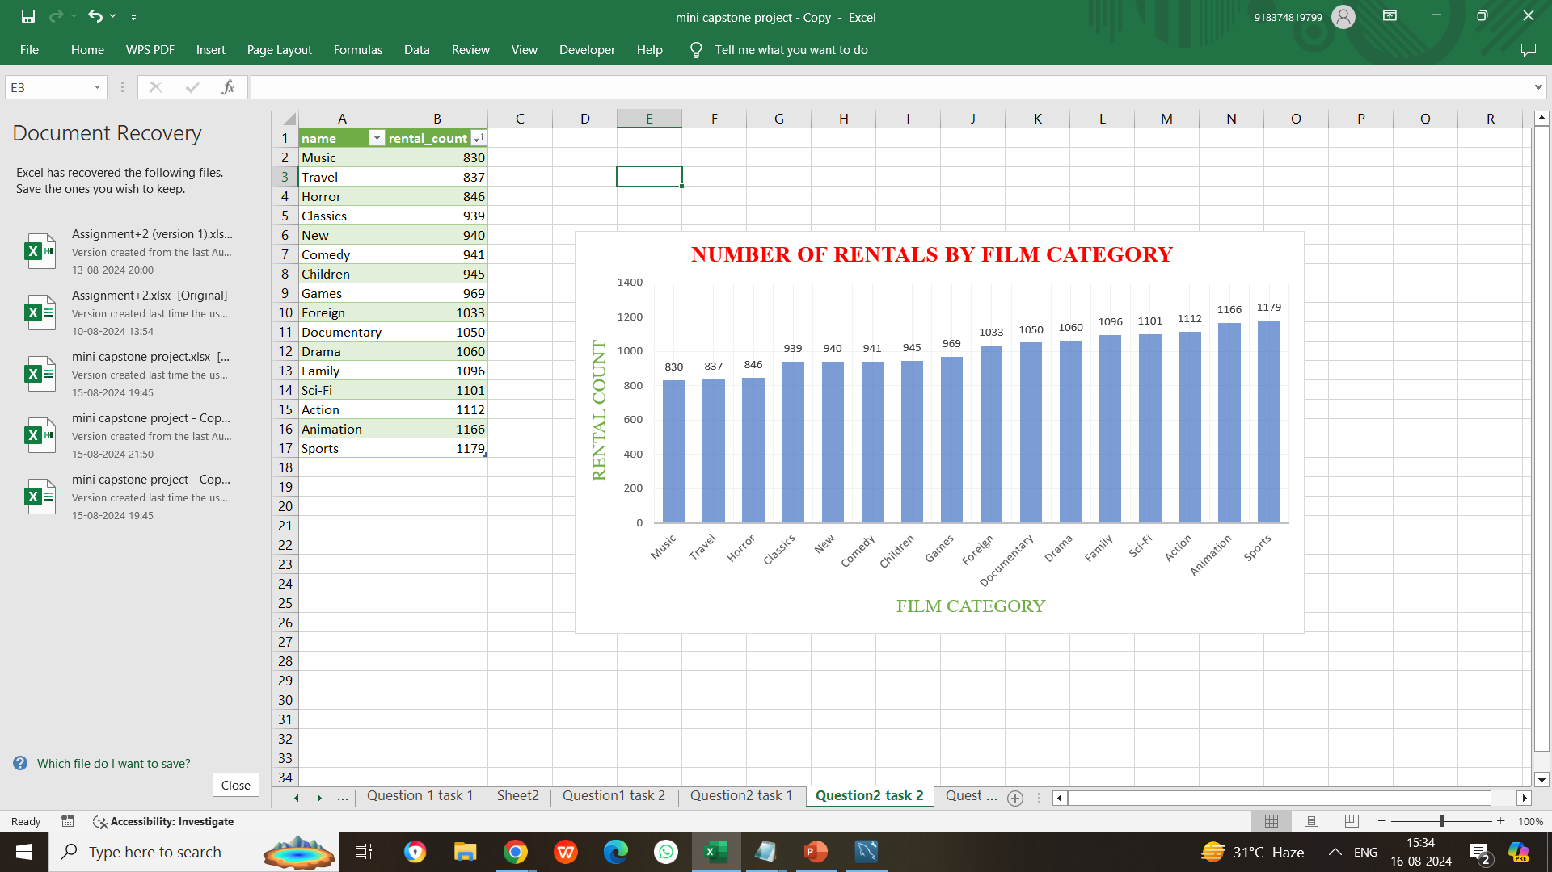
Visualization of clustered column chart showing film categories with highest rentals

Slide 15
Store with highest rental revenue query
SELECT
s.store_id AS Store_ID,
SUM(p.amount) AS Total_Revenue
FROM
payment p
JOIN
staff st ON p.staff_id = st.staff_id
JOIN
store s ON st.store_id = s.store_id
GROUP BY
s.store_id
ORDER BY
Total_Revenue DESC;

Slide 16
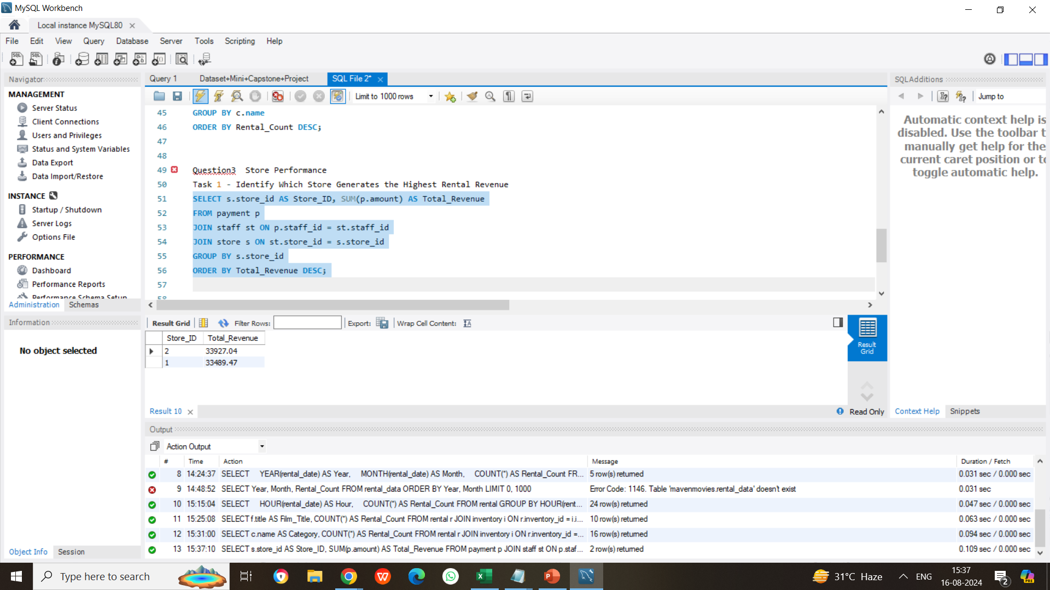
Screenshot of query in mysql workbench

Slide 17
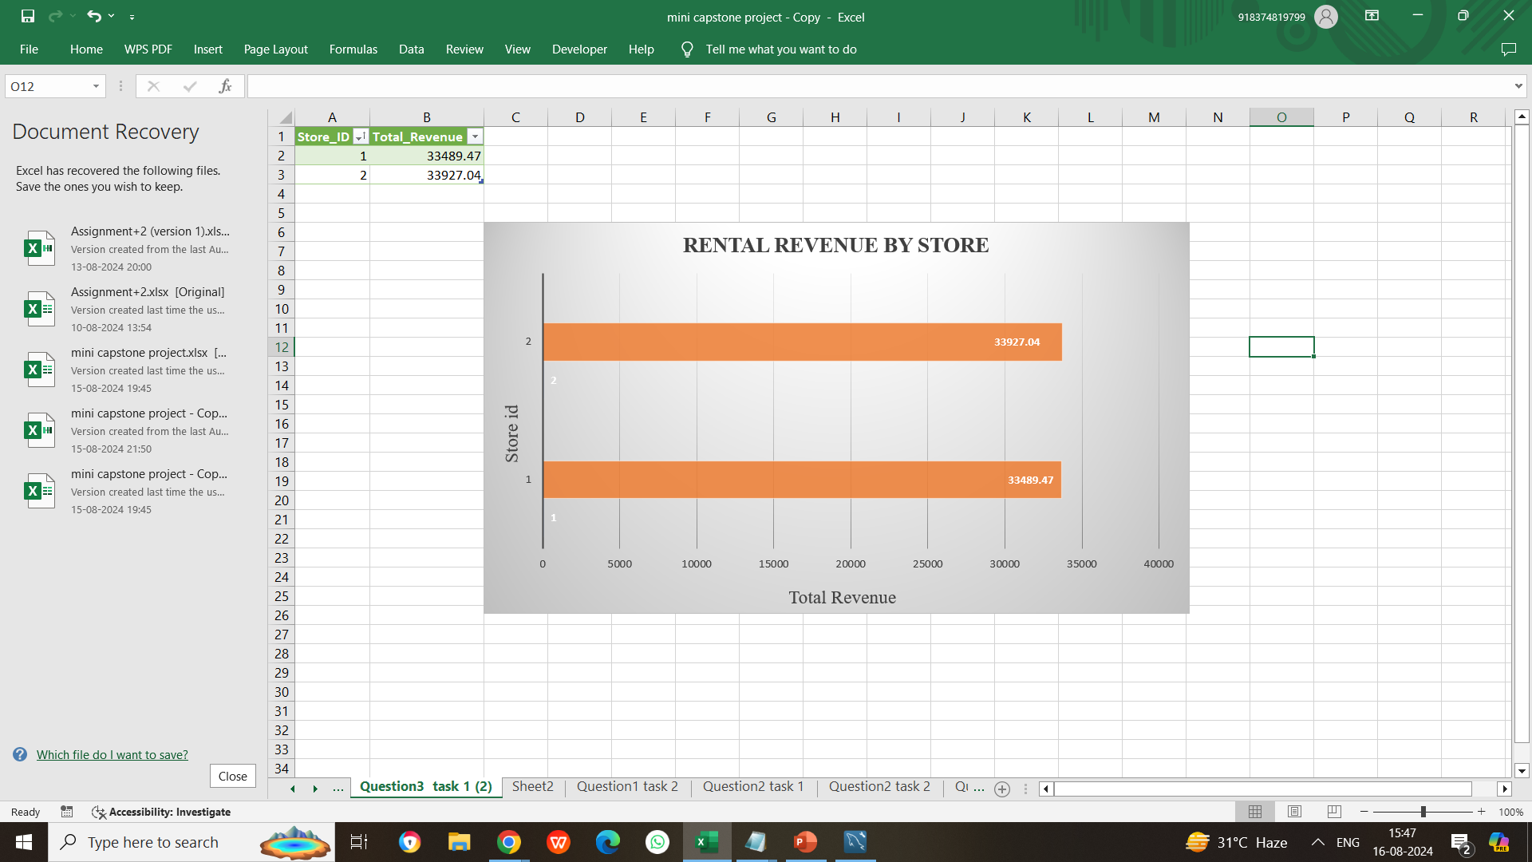
Clustered bar chart showing the total revenue by store

Slide 18
Rental distribution by staff query
SELECT
st.staff_id,
COUNT(*) AS Rental_Count
FROM
rental r
JOIN
staff st ON r.staff_id = st.staff_id
GROUP BY
st.staff_id
ORDER BY
Rental_Count DESC;

Slide 19
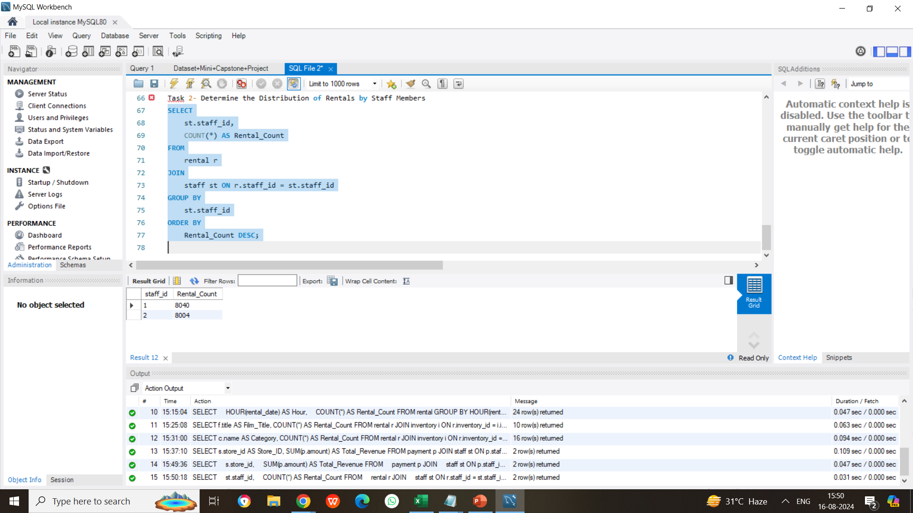
Screenshot of rental distribution of staff in my sql workbench

Slide 20
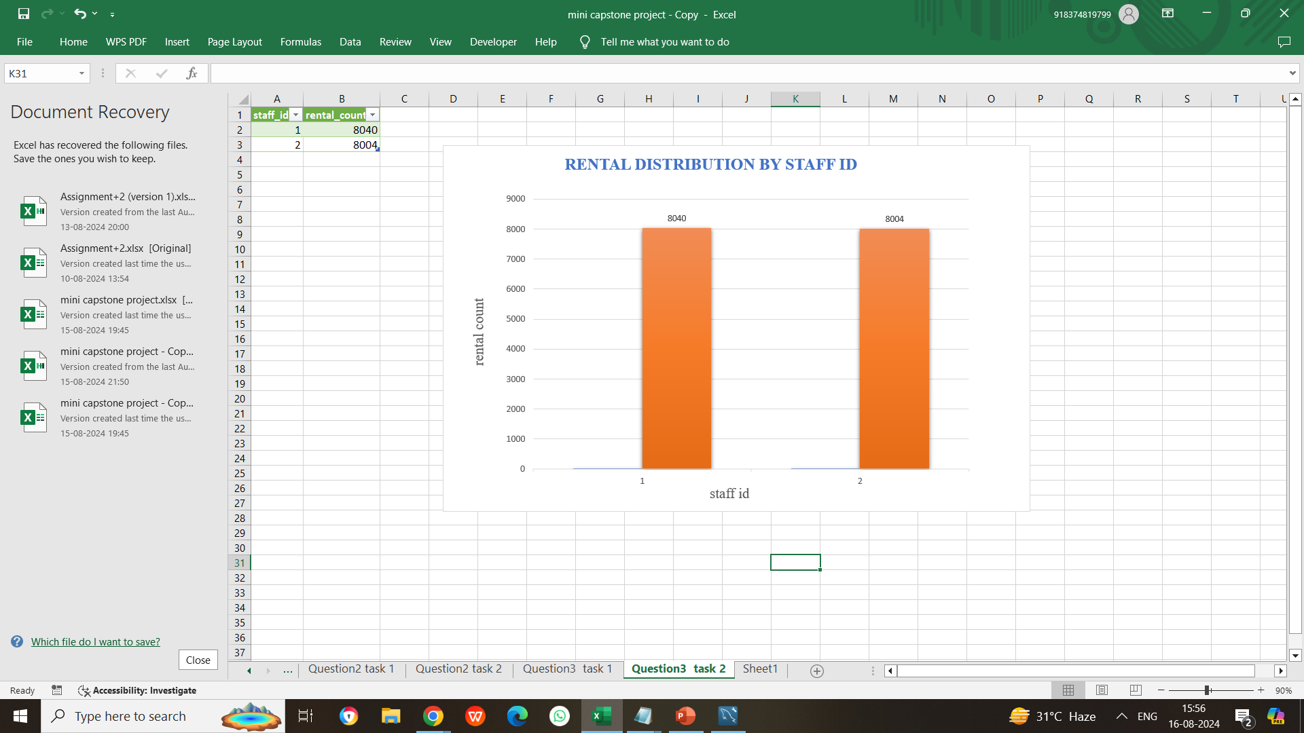
Clustered column chart showing rental distribution by staff id

Slide 21
INSIGHTS OF THE PROJECT
Rental Trends:
Identified peak rental months and times, providing valuable information to optimize store operations and staffing.
Film Popularity:
Highlighted the top 10 most rented films and popular film categories, which can inform inventory management and targeted marketing strategies.
Store Performance:
Determined which store generates the highest rental revenue and assessed staff performance, offering actionable insights to enhance operational efficiency and staff effectiveness.

Slide 22
CONCLUSION
The analysis of rental patterns, film popularity, and store performance provides valuable insights that drive operational improvements.
By understanding peak rental times, popular films, and high-performing stores, businesses can optimize staffing, tailor inventory to customer preferences, and enhance overall store efficiency.
These findings support strategic decisions to boost revenue and improve customer satisfaction.

Slide 23
THANK YOU

